Slide 1



Quantifying the effect of experimental perturbations on scRNA-seq data
bit.ly/quantsinglecell
github.com/KrishnaswamyLab/MELD
@dbburkhardt
Daniel Burkhardt
Krishnaswamy Lab, Department of Genetics, Yale University

Slide 2
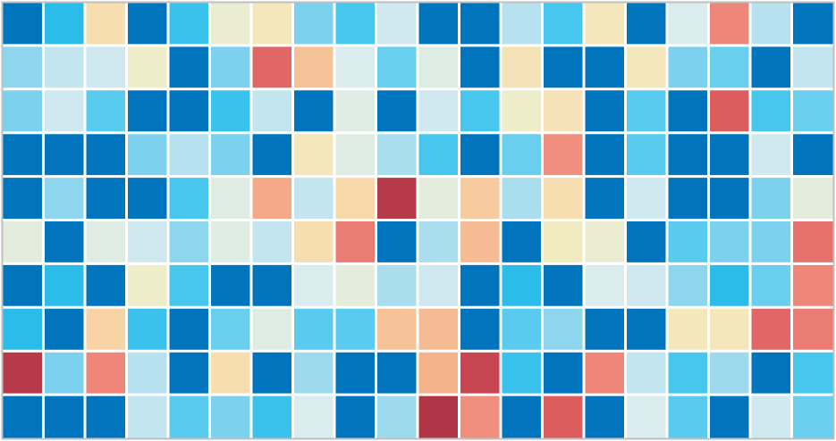
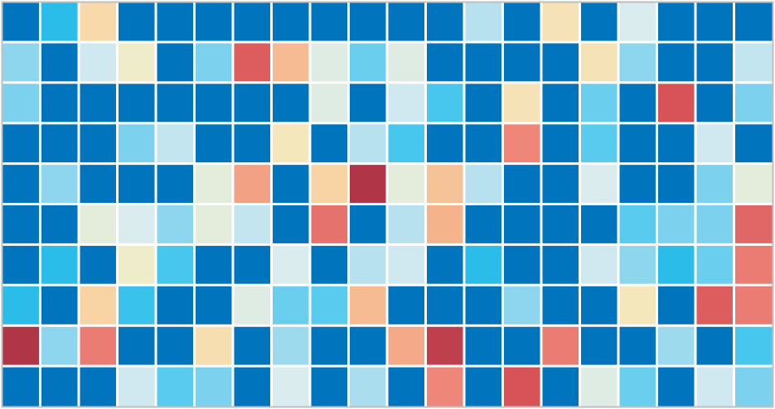
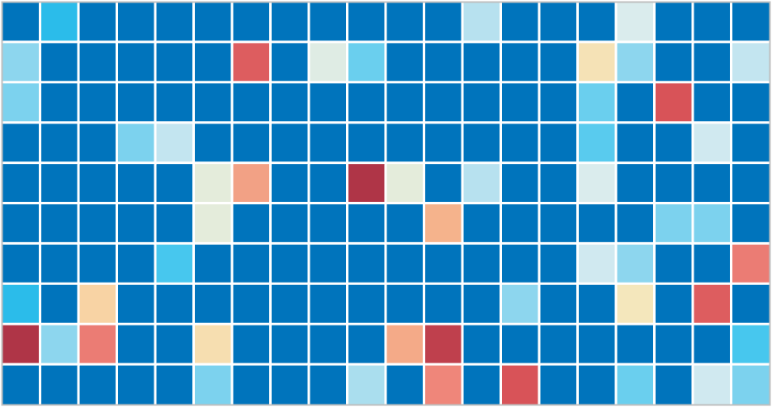
genes
cells
Biomedical data is noisy and sparse. How can we understand the relationships between observations (here, cells) and features (here, genes)?
Notes:
ideally: measure the expression of every gene in every
Samples only a small part of the transcriptome per cell
-- Tens of millions of individual measurements

Slide 3
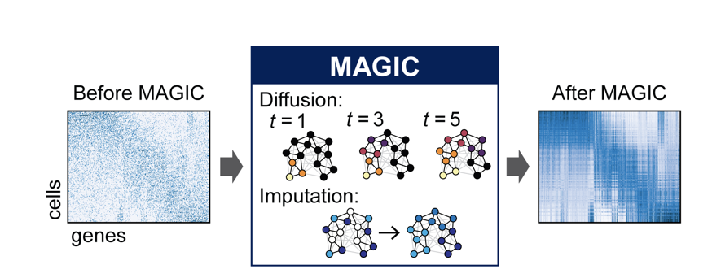
Diffusing Values to Impute
Van Dijk et al. Recovering Gene Interactions from Single-Cell Data Using Data Diffusion. Cell. 2018

Slide 4
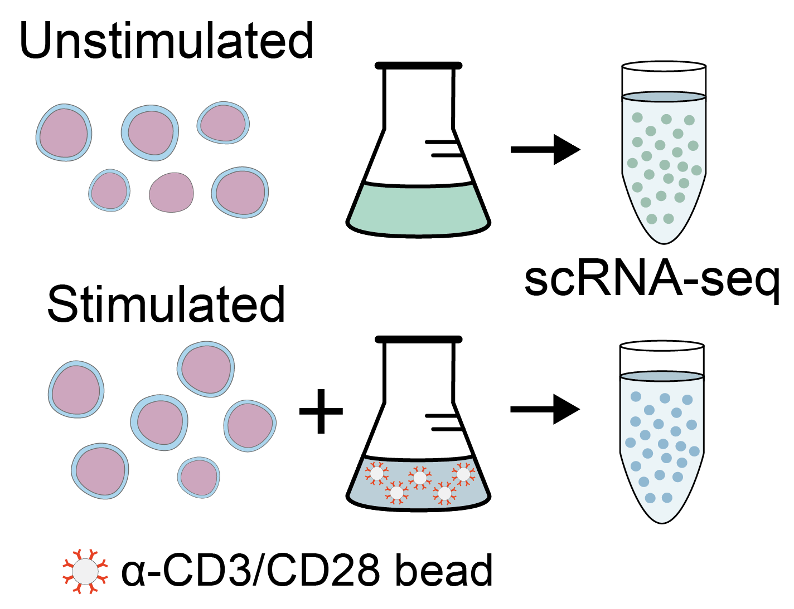
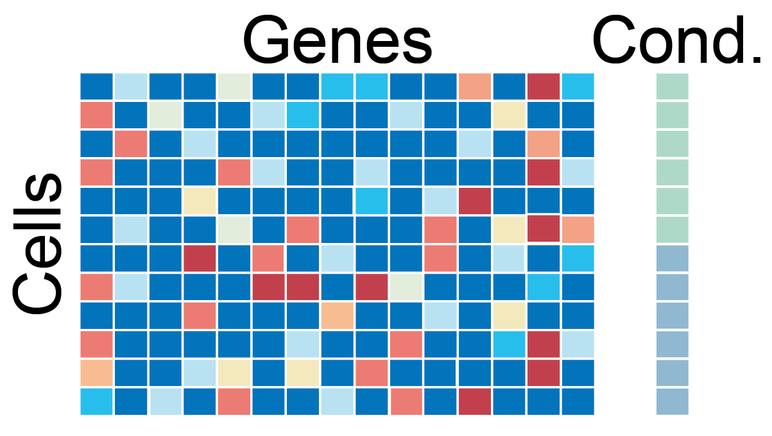
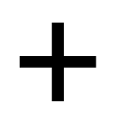
Measuring the difference between two experiments
Datlinger, P. et al. Pooled CRISPR screening with single-cell transcriptome readout. Nature Methods (2017).

Slide 5
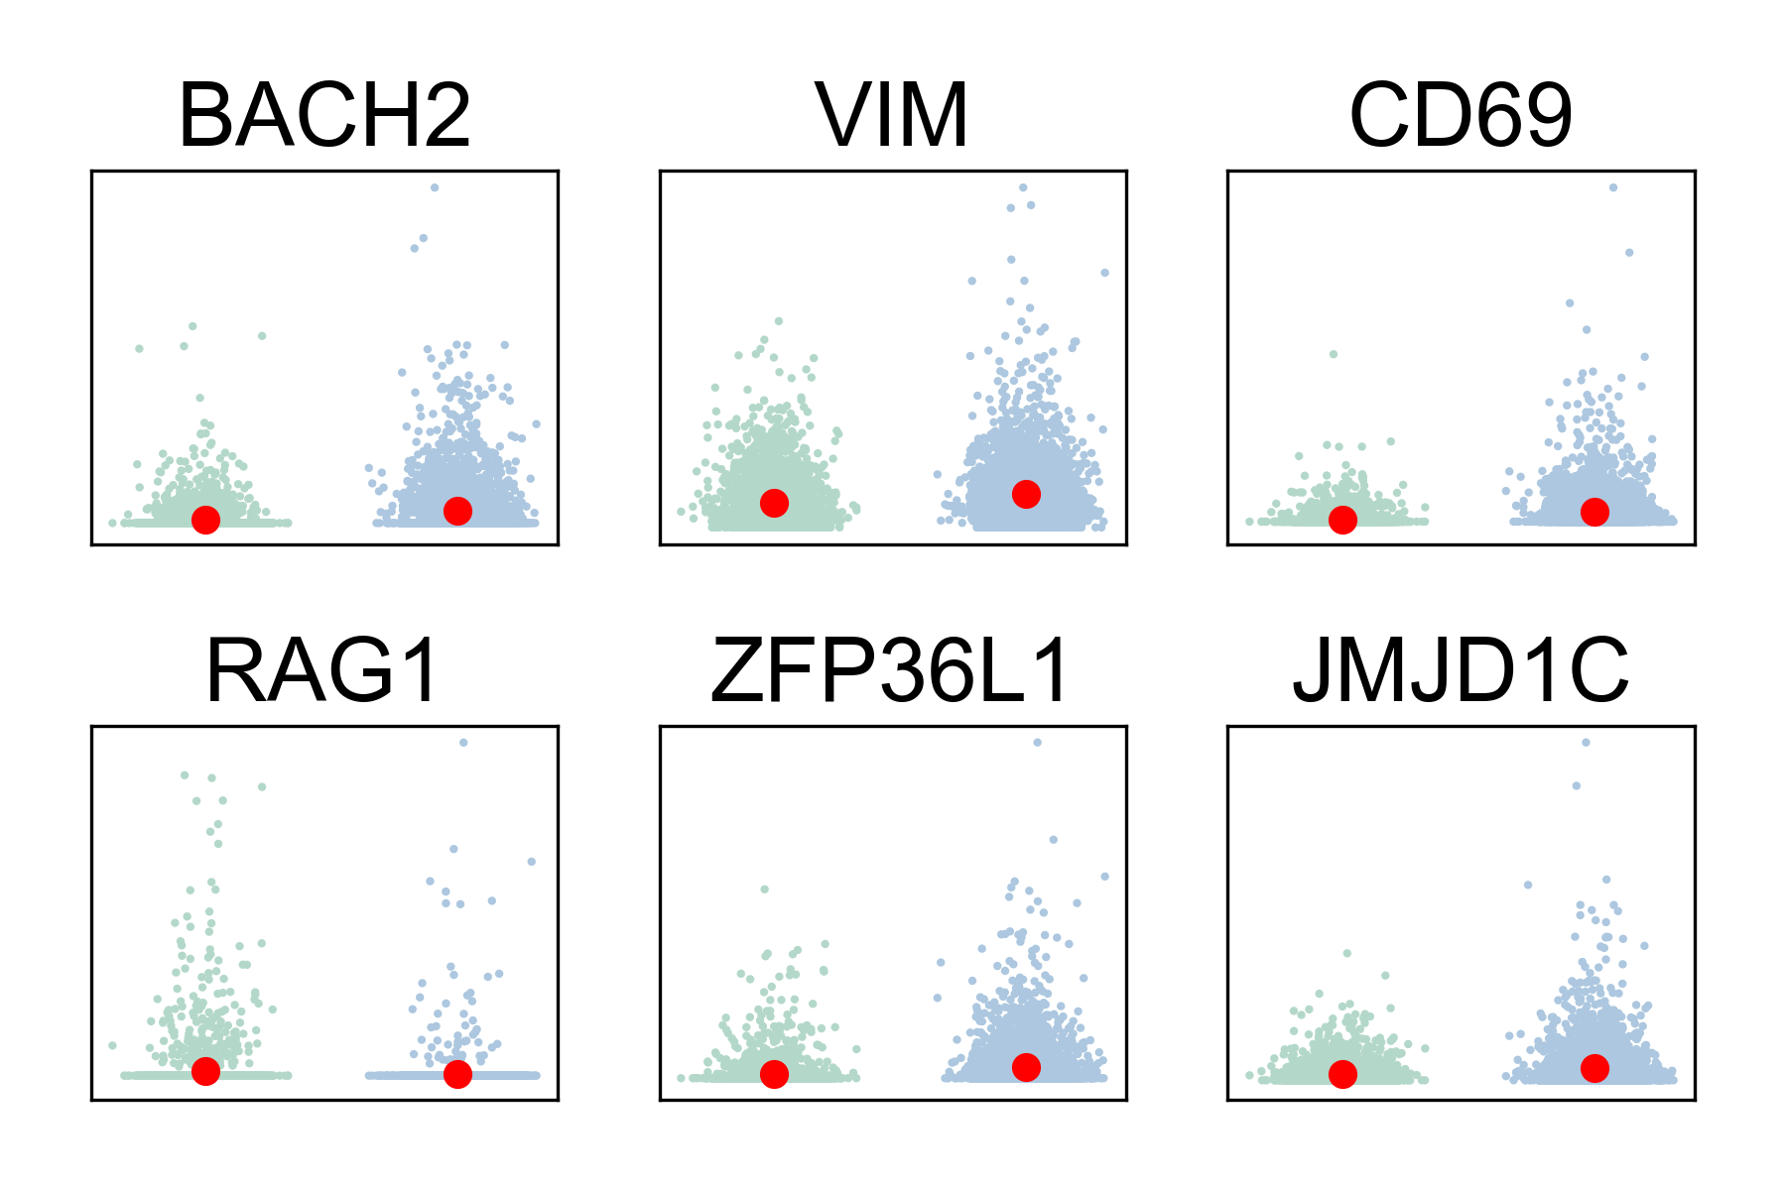
Expression
Naive
Stim.
Naive
Stim.
Naive
Stim.
Datlinger, P. et al. CRISPR screening with single-cell transcriptome readout. Nature Methods (2017).

Slide 6
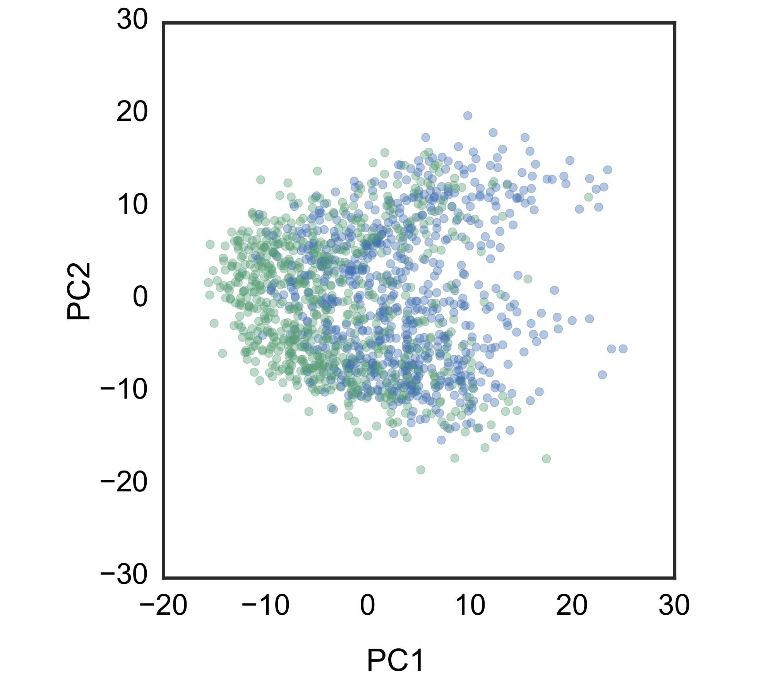
How do we measure the effect of TCR stimulation on T cell activation?
PC2
PC1
Datlinger, P. et al. Pooled CRISPR screening with single-cell transcriptome readout. Nature Methods (2017).

Slide 7
How do we measure the effect of TCR stimulation on T cell activation?
PC2
Problem: Effect size is small relative to biological and technical noise
PC1
Datlinger, P. et al. Pooled CRISPR screening with single-cell transcriptome readout. Nature Methods (2017).

Slide 8
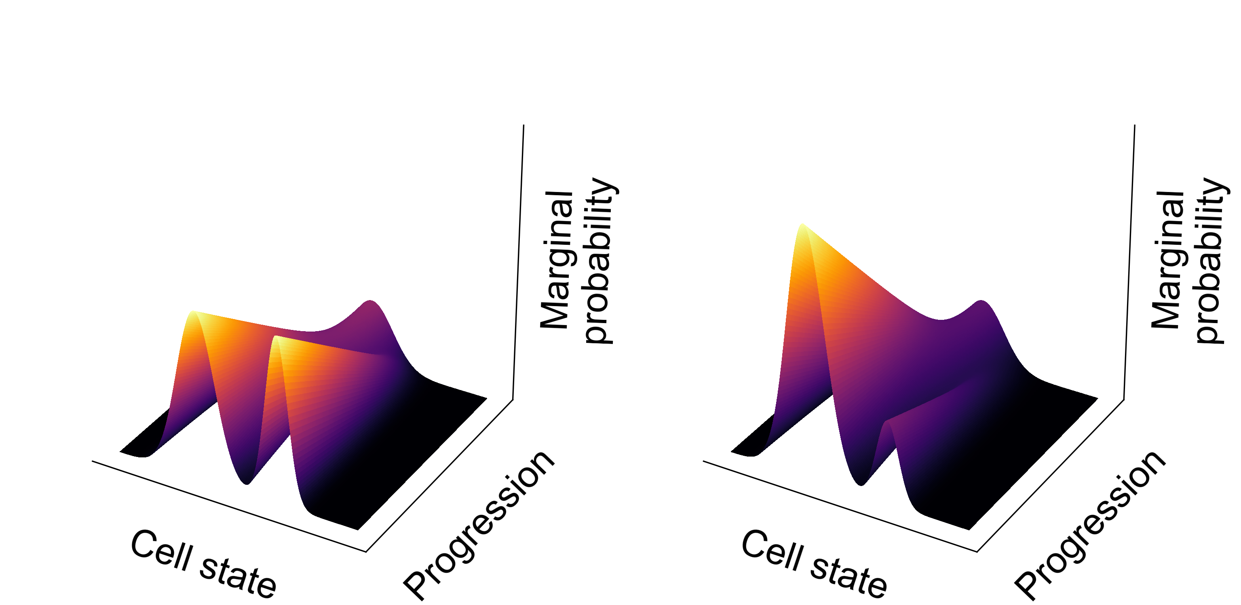
Goal: Quantify difference in data density
Control
After perturbation
Data Density
Data Density
Cell state
Cell state

Slide 9
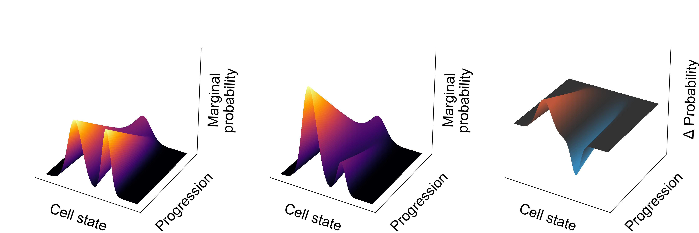
Goal: Quantify difference in data density
Control
After perturbation
Effect of experiment
Data Density
Data Density
Δ Density
Cell state
Cell state
Cell state

Slide 10
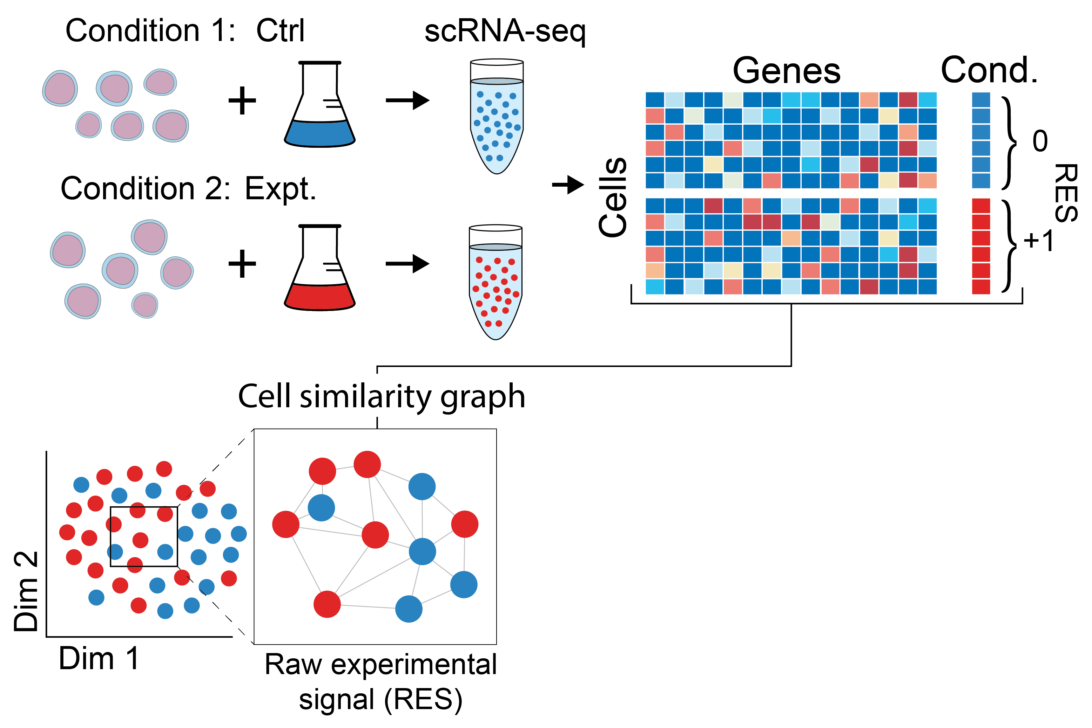
Experimental signal on cell graph

Slide 11
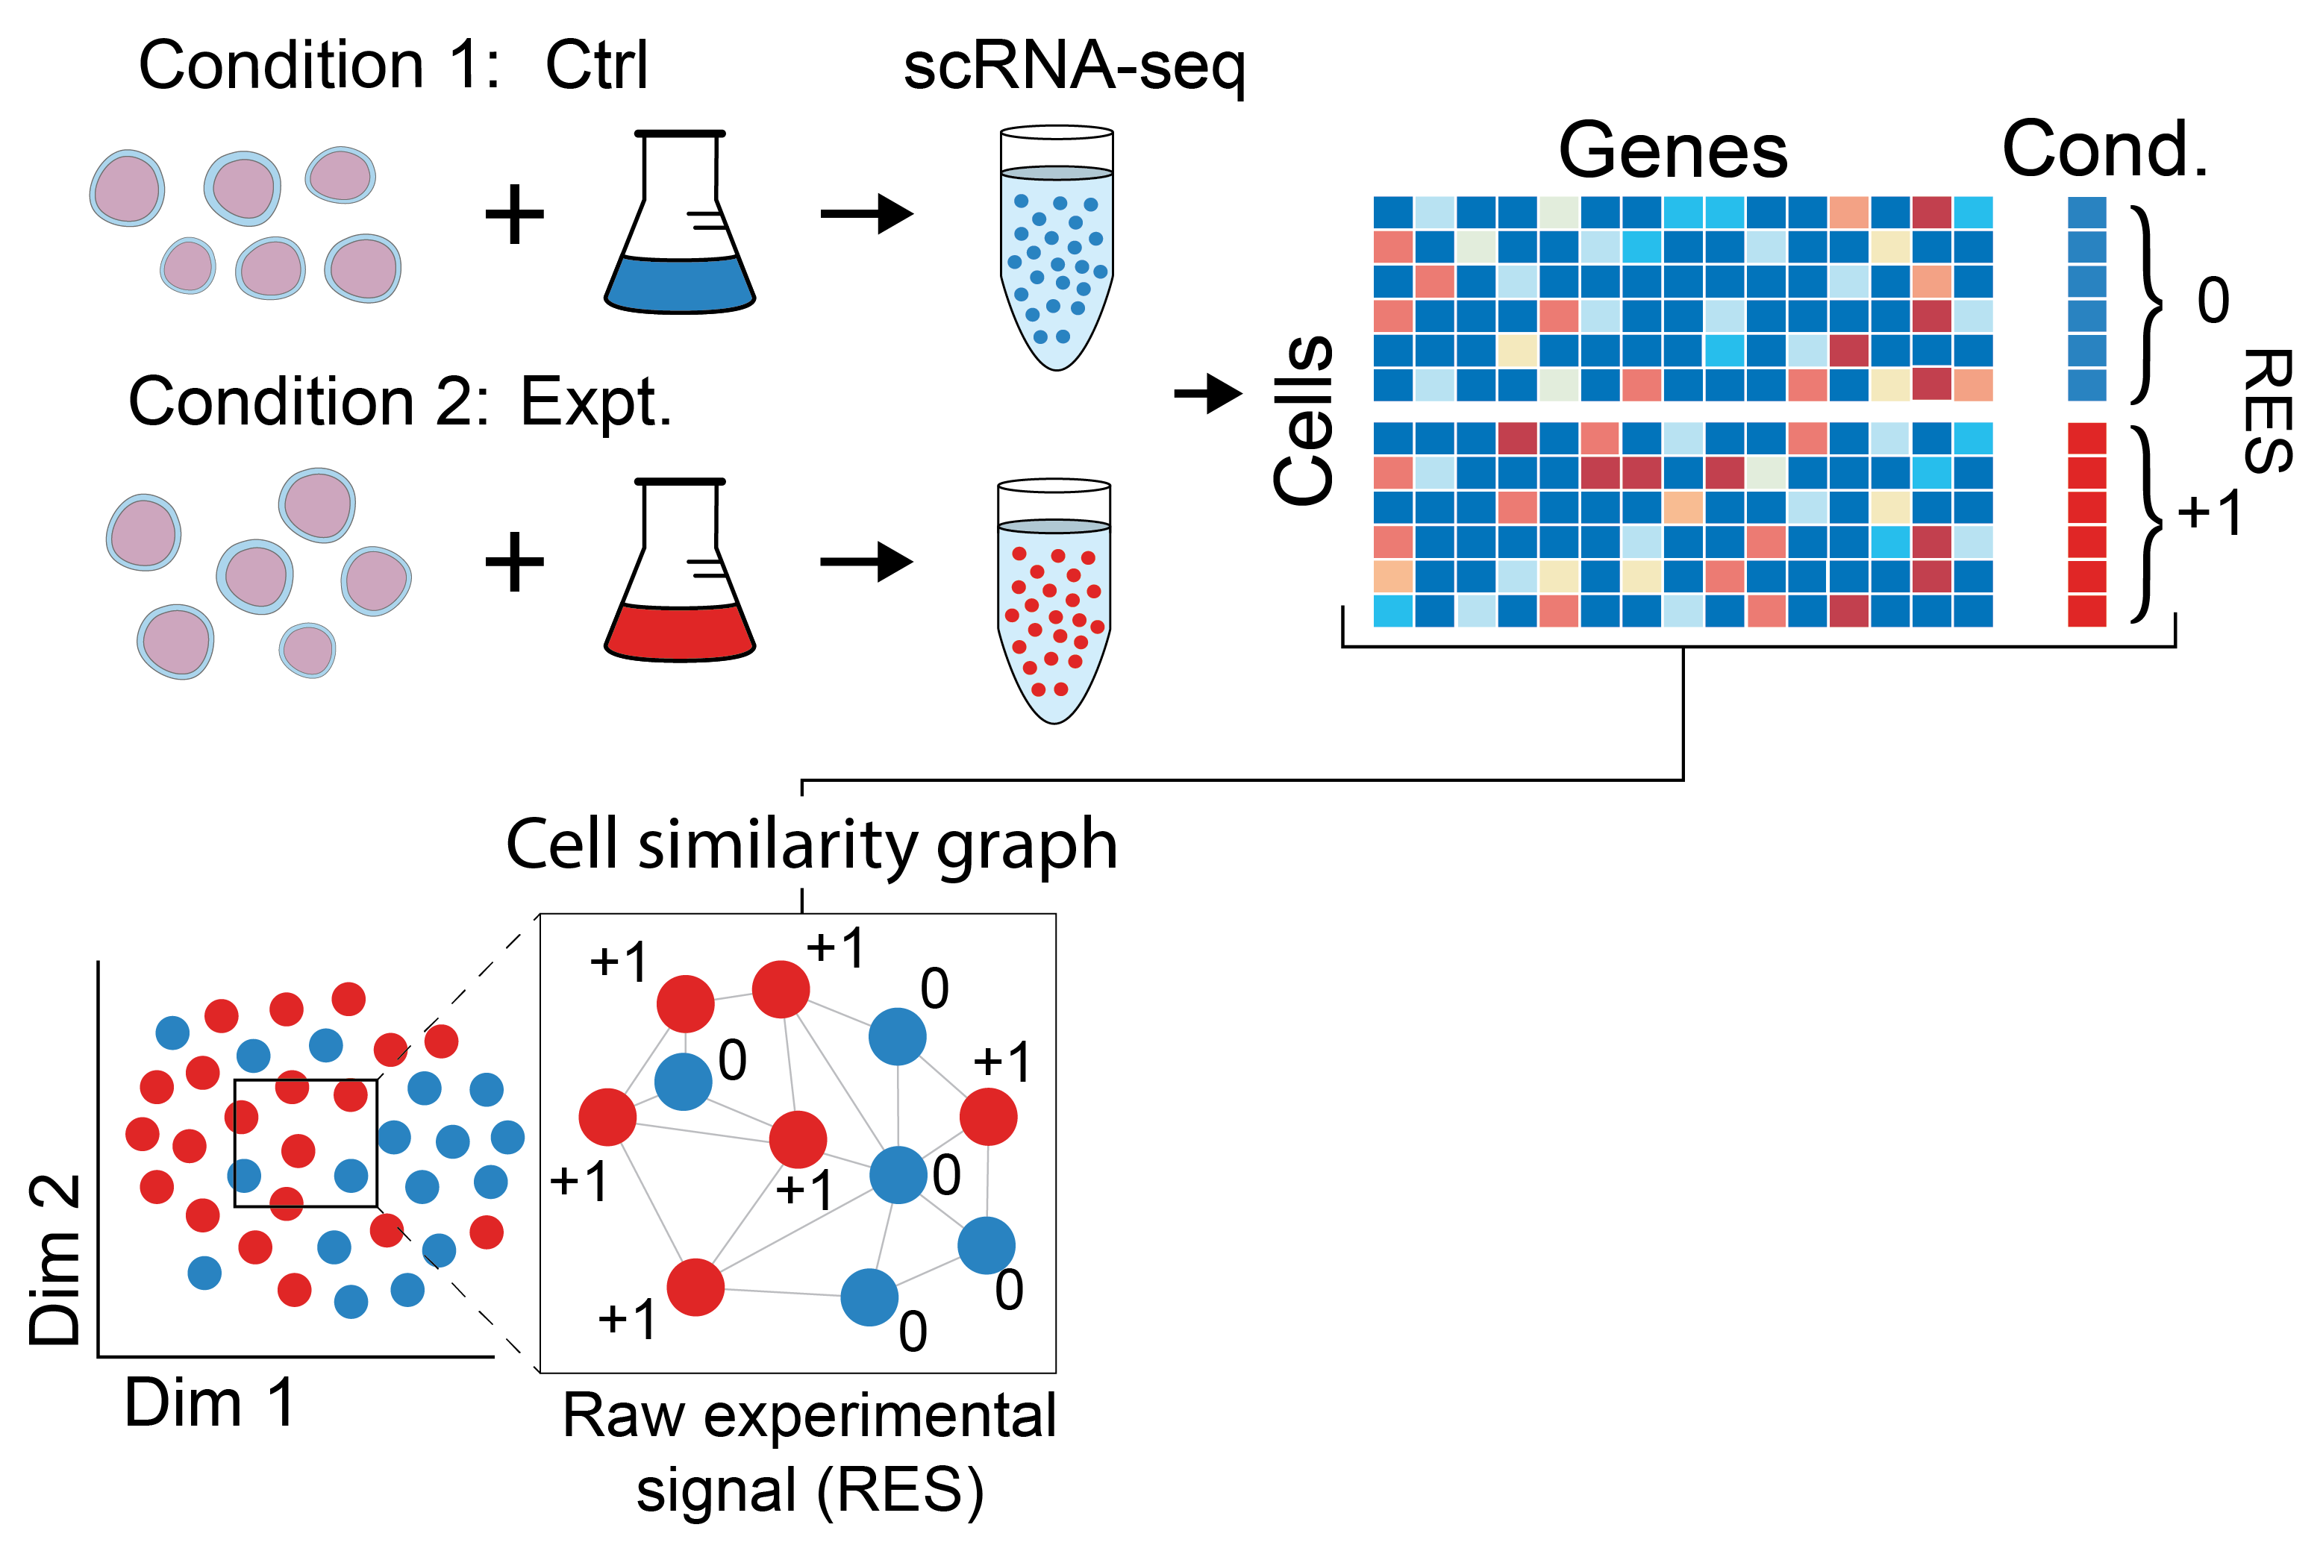
Experimental signal on cell graph

Slide 12
Experimental signal on cell graph
This raw experimental signal has contaminating noise due to:
Measurement error
Biological heterogeneity
Small/uneven effect size

Slide 13
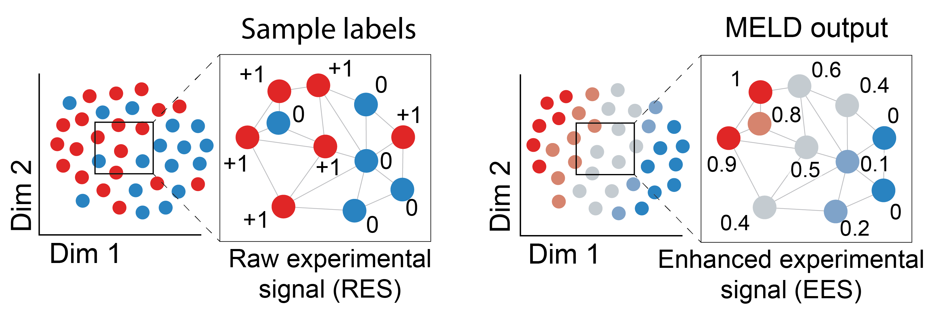
Smoothing signal removes high frequency noise

Slide 14
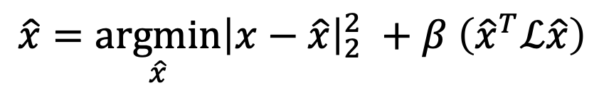
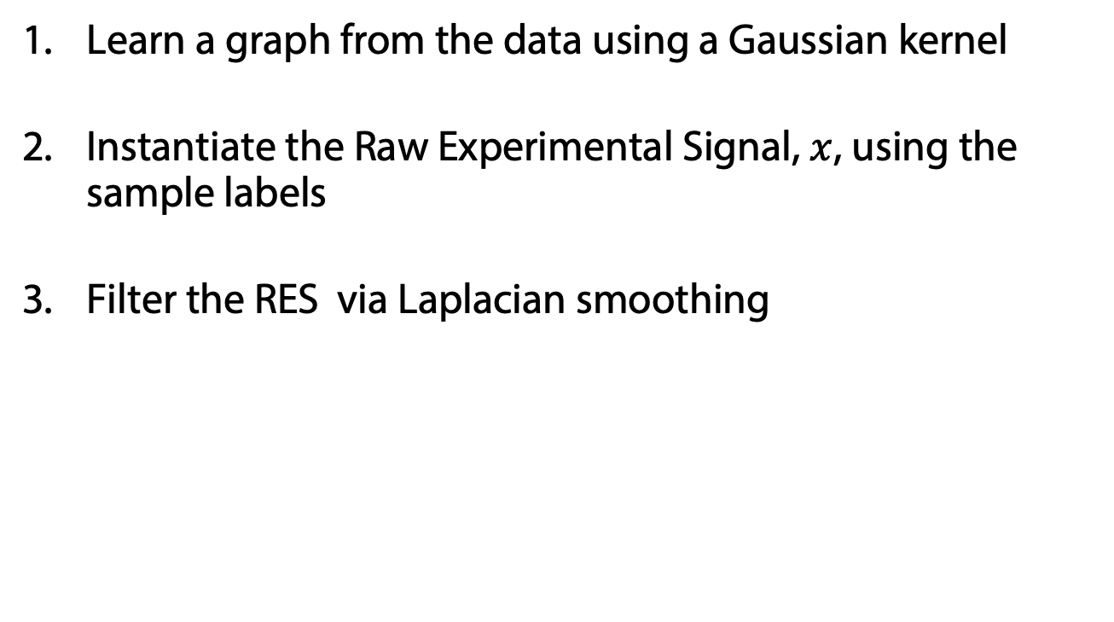
The MELD algorithm
Learn a graph from the data using a Gaussian kernel
Instantiate the Raw Experimental Signal, $x$, using the sample labels
Filter the RES via Laplacian smoothing
$$\hat{x}=\underset{\hat{x}}{argmin}{{\left|x−\hat{x}\right|}_{2}^{2} +β \left({\hat{x}}^{T}ℒ\hat{x}\right)}$$
Burkhardt et al. Enhancing experimental signals in single-cell
RNA-sequencing data using graph signal processing. BioRxiv. 2019

Slide 15
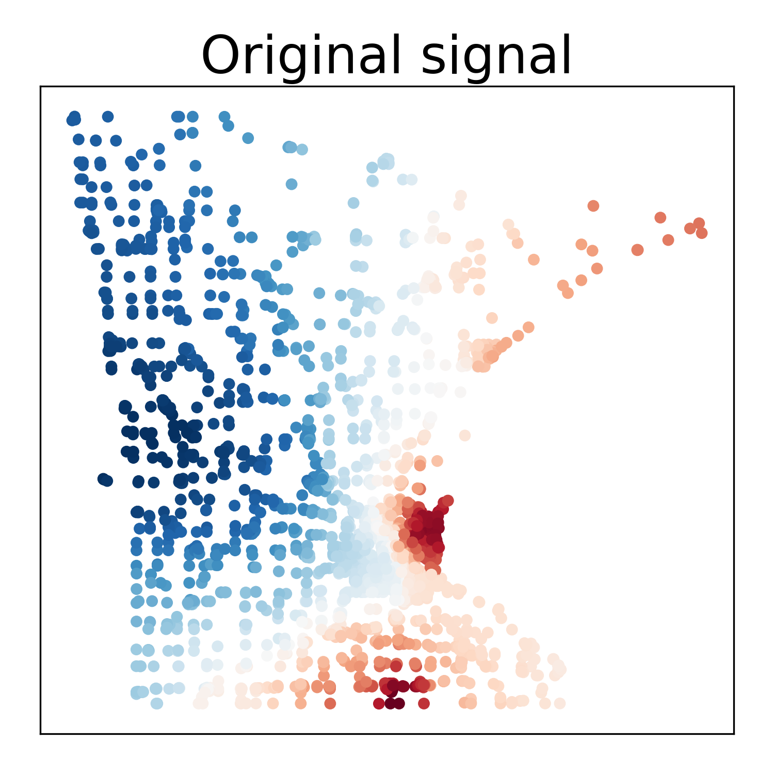
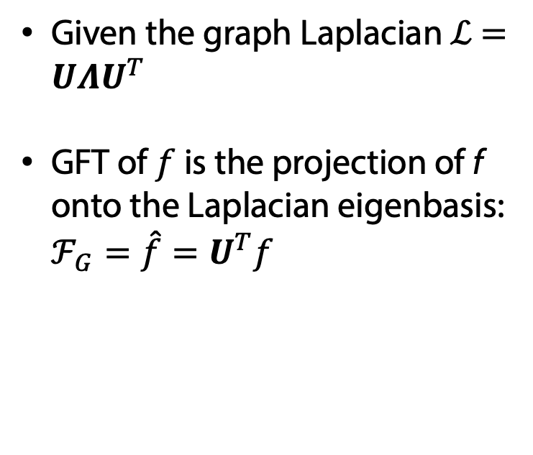
Lowpass filtering recovers low frequency signals
Given the graph Laplacian $ℒ$ $=UΛU^{T}$
GFT of $f$ is the projection of f onto the Laplacian eigenbasis: $ℱ_{G}=\hat{f}=U^{T}f$

Slide 16
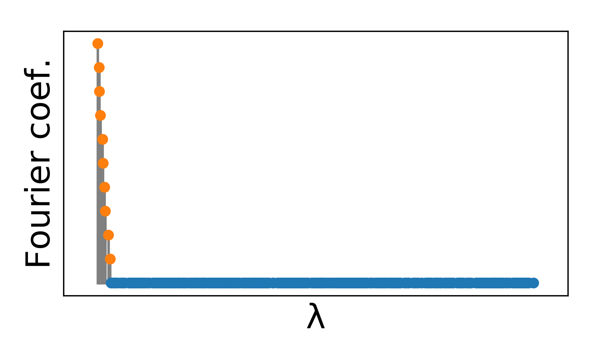
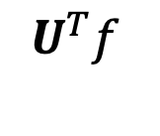
Lowpass filtering recovers low frequency signals
GFT
$$U^{T}f$$

Slide 17
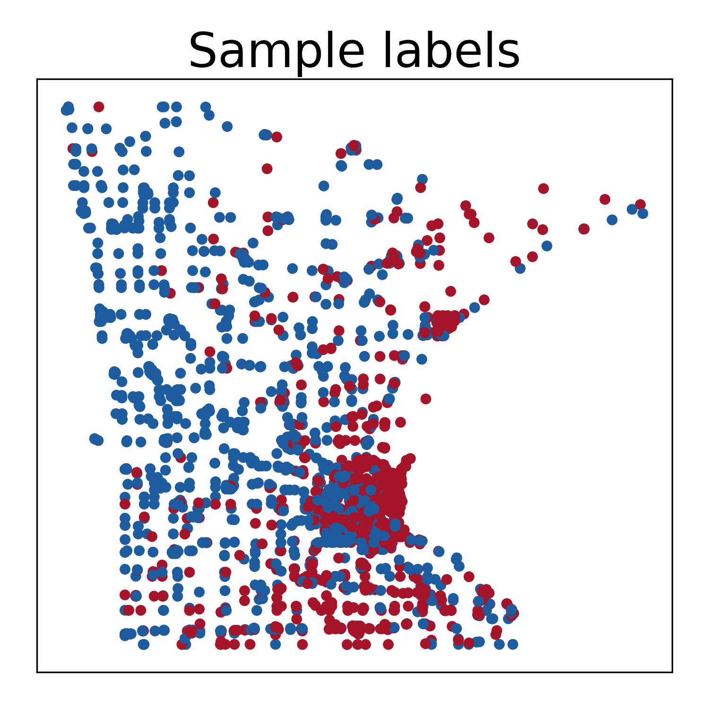
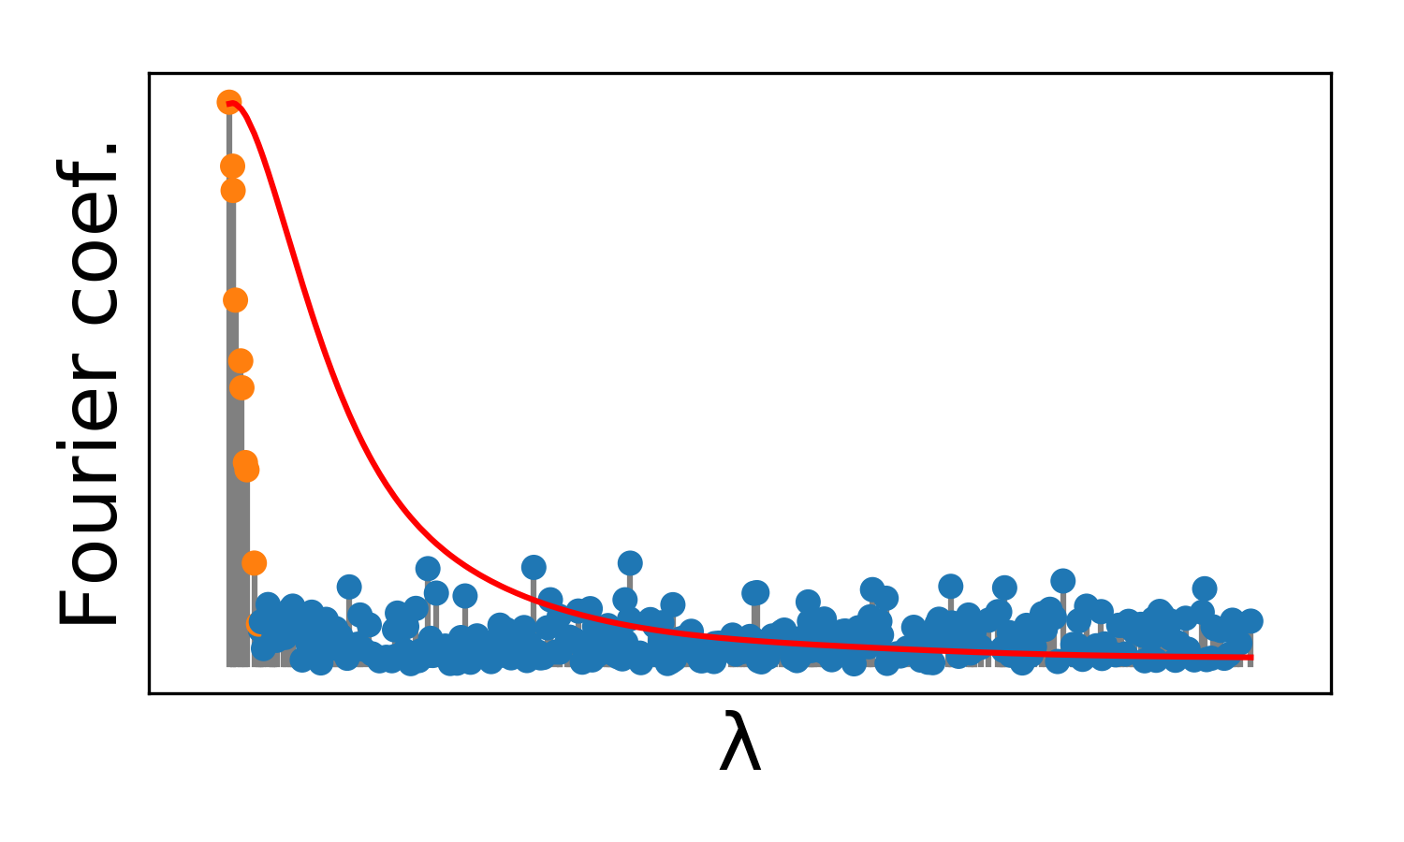
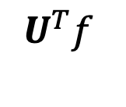
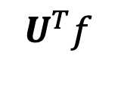
Lowpass filtering recovers low frequency signals
GFT
$$U^{T}f$$
GFT
$$U^{T}f$$

Slide 18
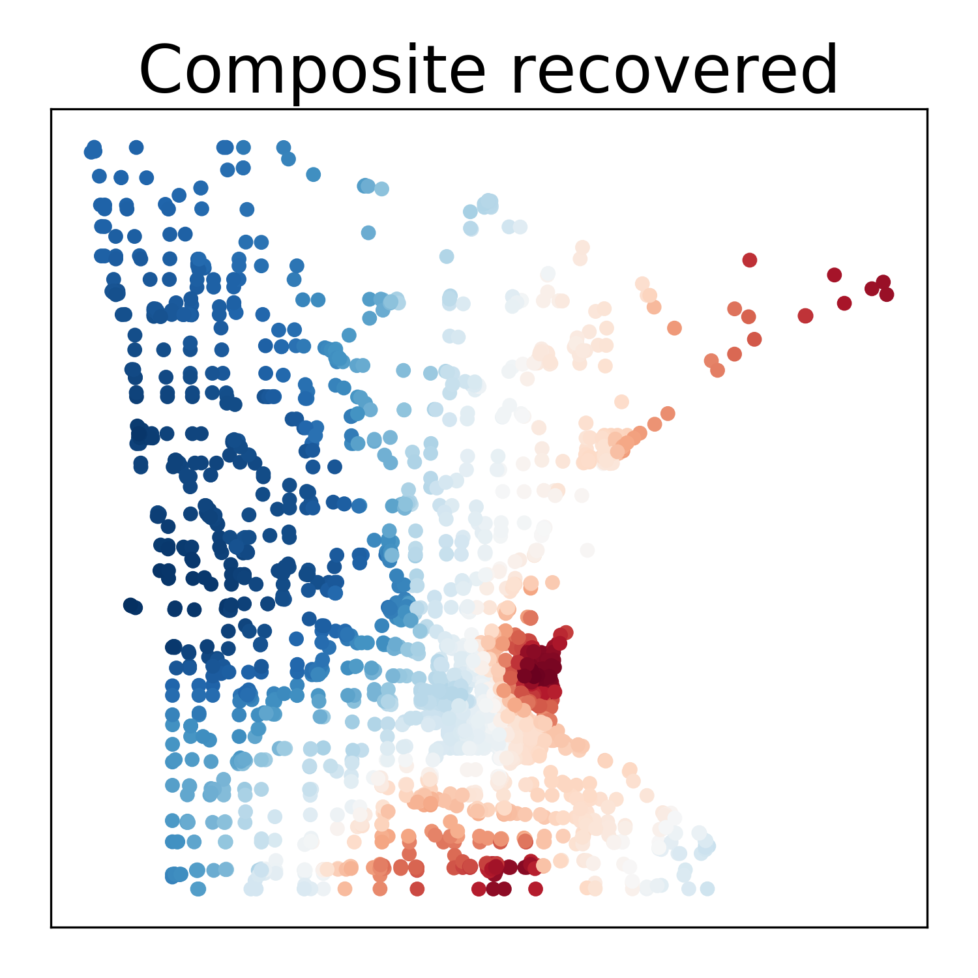
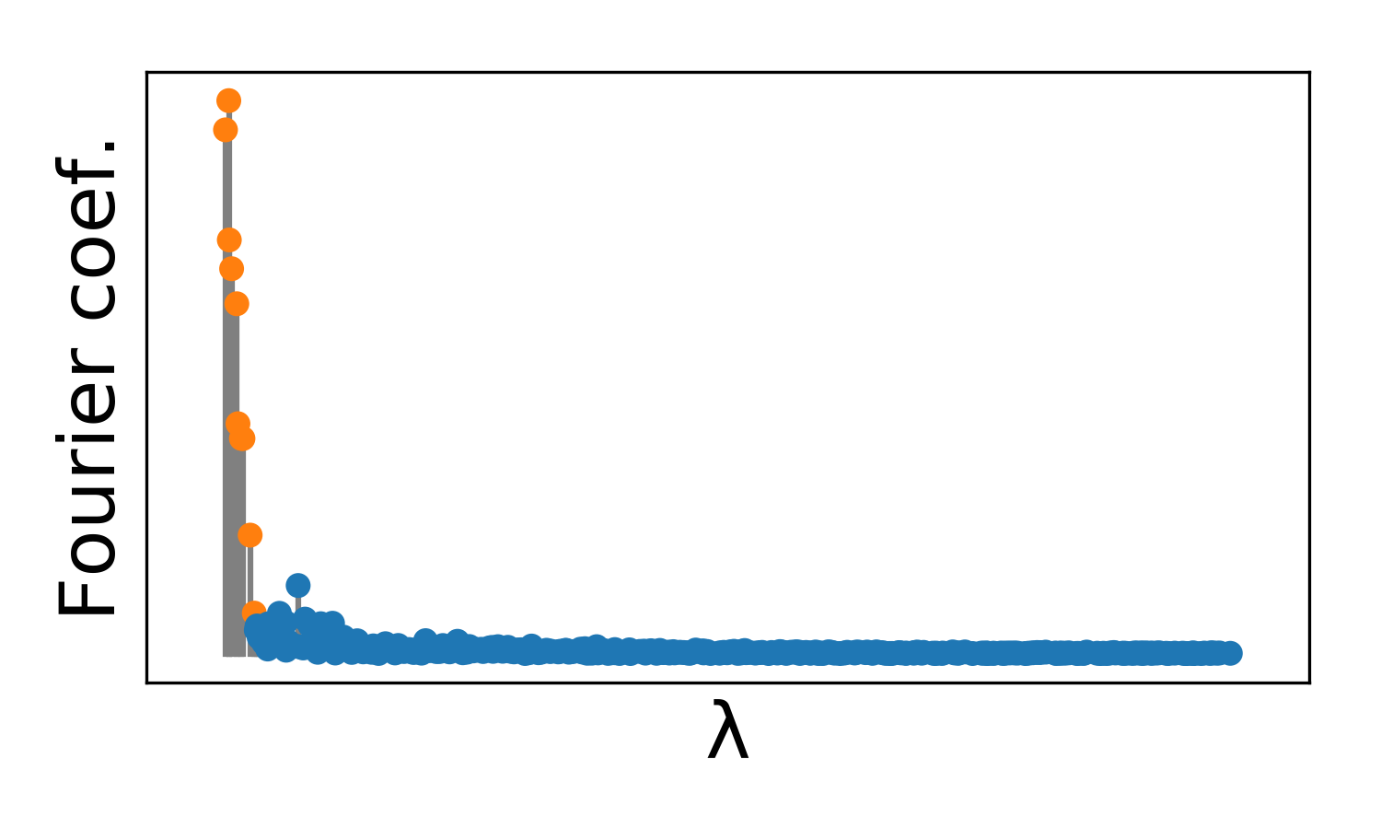
Lowpass filtering recovers low frequency signals
GFT
$$U^{T}f$$
GFT
$$U^{T}f$$

Slide 19
The MELD algorithm
Learn a graph from the data using a Gaussian kernel
Instantiate the Raw Experimental Signal, $x$, using the sample labels
Filter the RES via Laplacian smoothing
$$\hat{x}=\underset{\hat{x}}{argmin}{{\left|x−\hat{x}\right|}_{2}^{2} +β \left({\hat{x}}^{T}ℒ\hat{x}\right)}$$
biorxiv.org/content/10.1101/532846v1

Slide 20
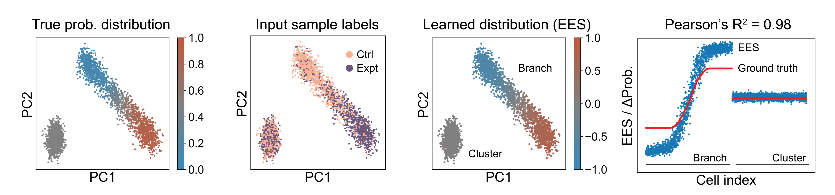
Simulated scRNA-seq data
Branch
Cluster

Slide 21
Simulated scRNA-seq data
Branch
Cluster

Slide 22
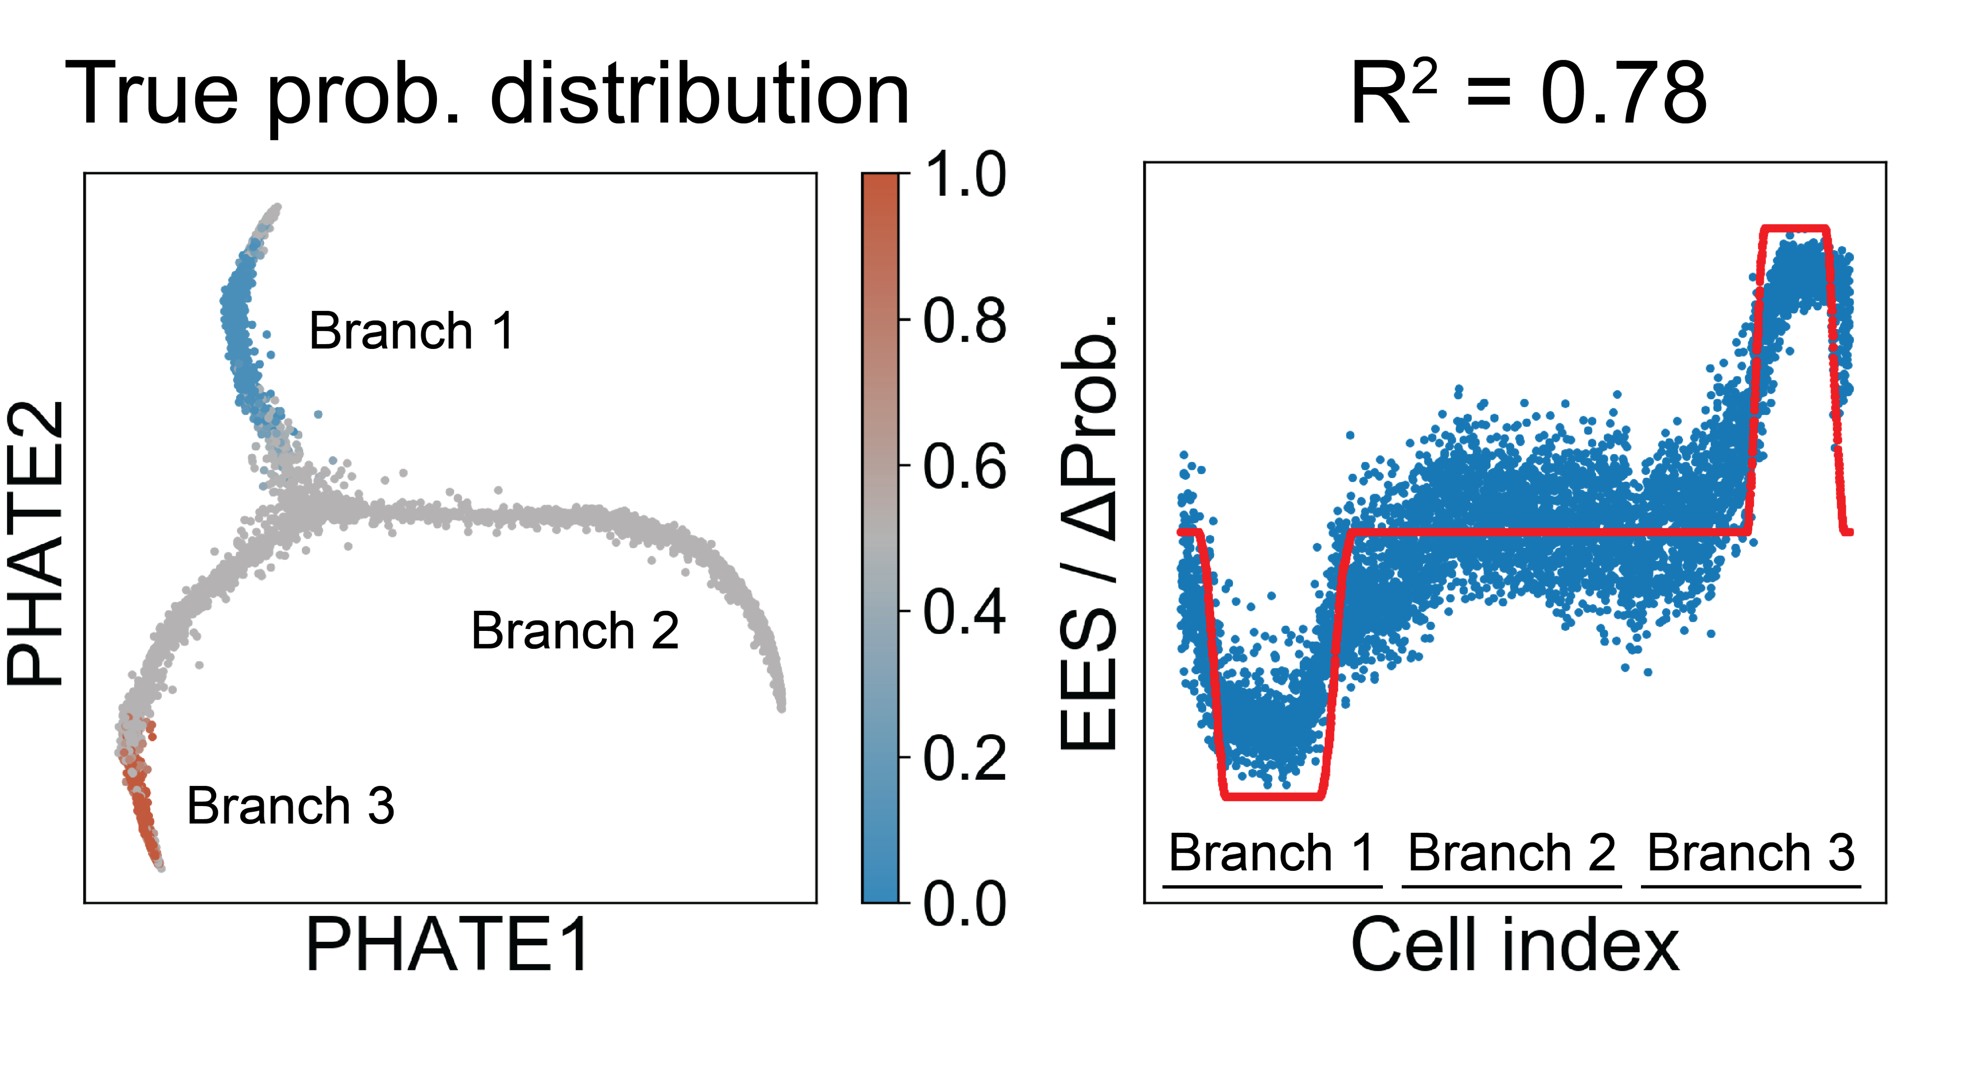
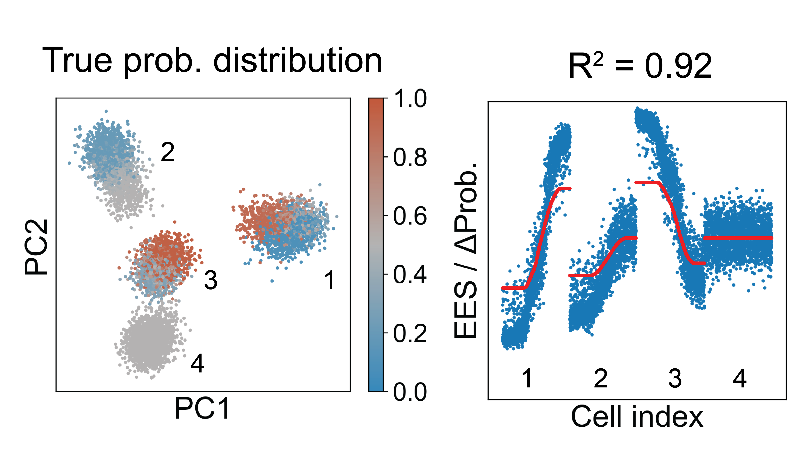
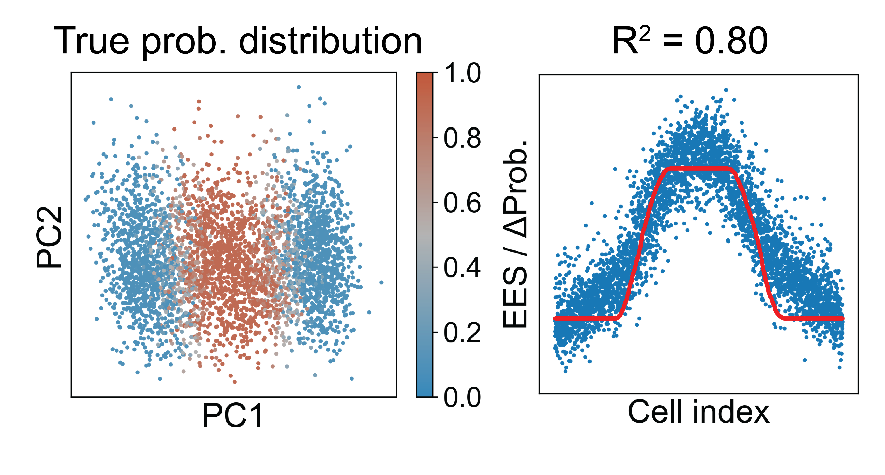
Simulated scRNA-seq data

Slide 23
Simulated scRNA-seq data

Slide 24
Simulated scRNA-seq data

Slide 25
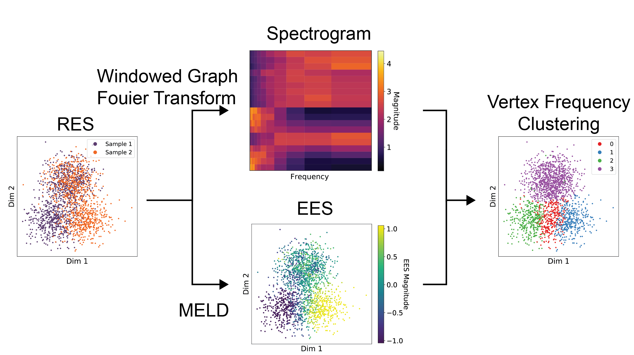
Vertex Frequency Clustering identifies clusters using RES and EES
Presented at DSW 2019

Slide 26
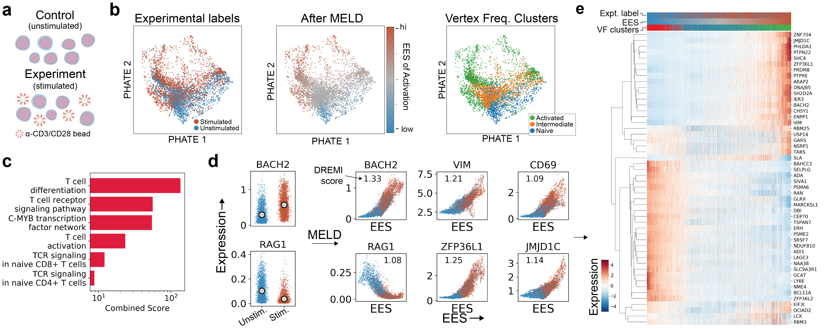
Directly analyzing experimental labels does not reveal effect of TCR induction

Slide 27
MELD reveals a continuous spectrum of TCR induction

Slide 28
The EES identifies the signature of TCR induction

Slide 29
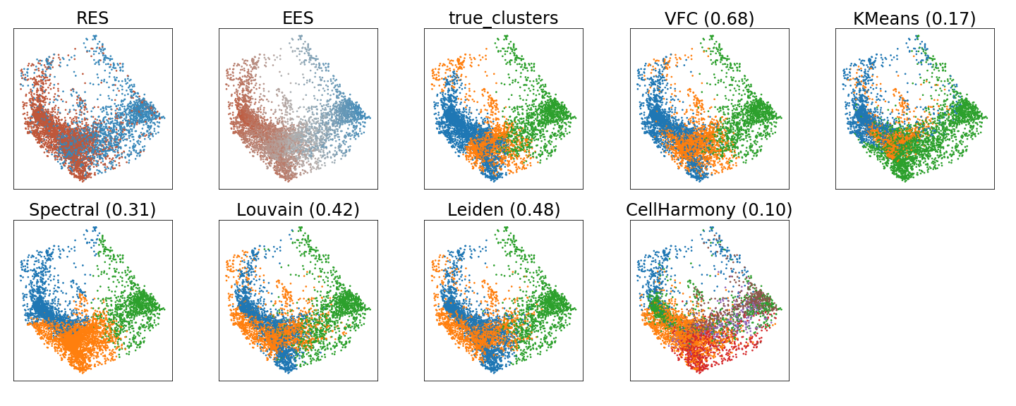
VFC identifies enriched groups of cells better than other methods
(adjusted rand score)

Slide 30
The EES identifies the signature of TCR induction
Top 1% genes associated with EES

Slide 31
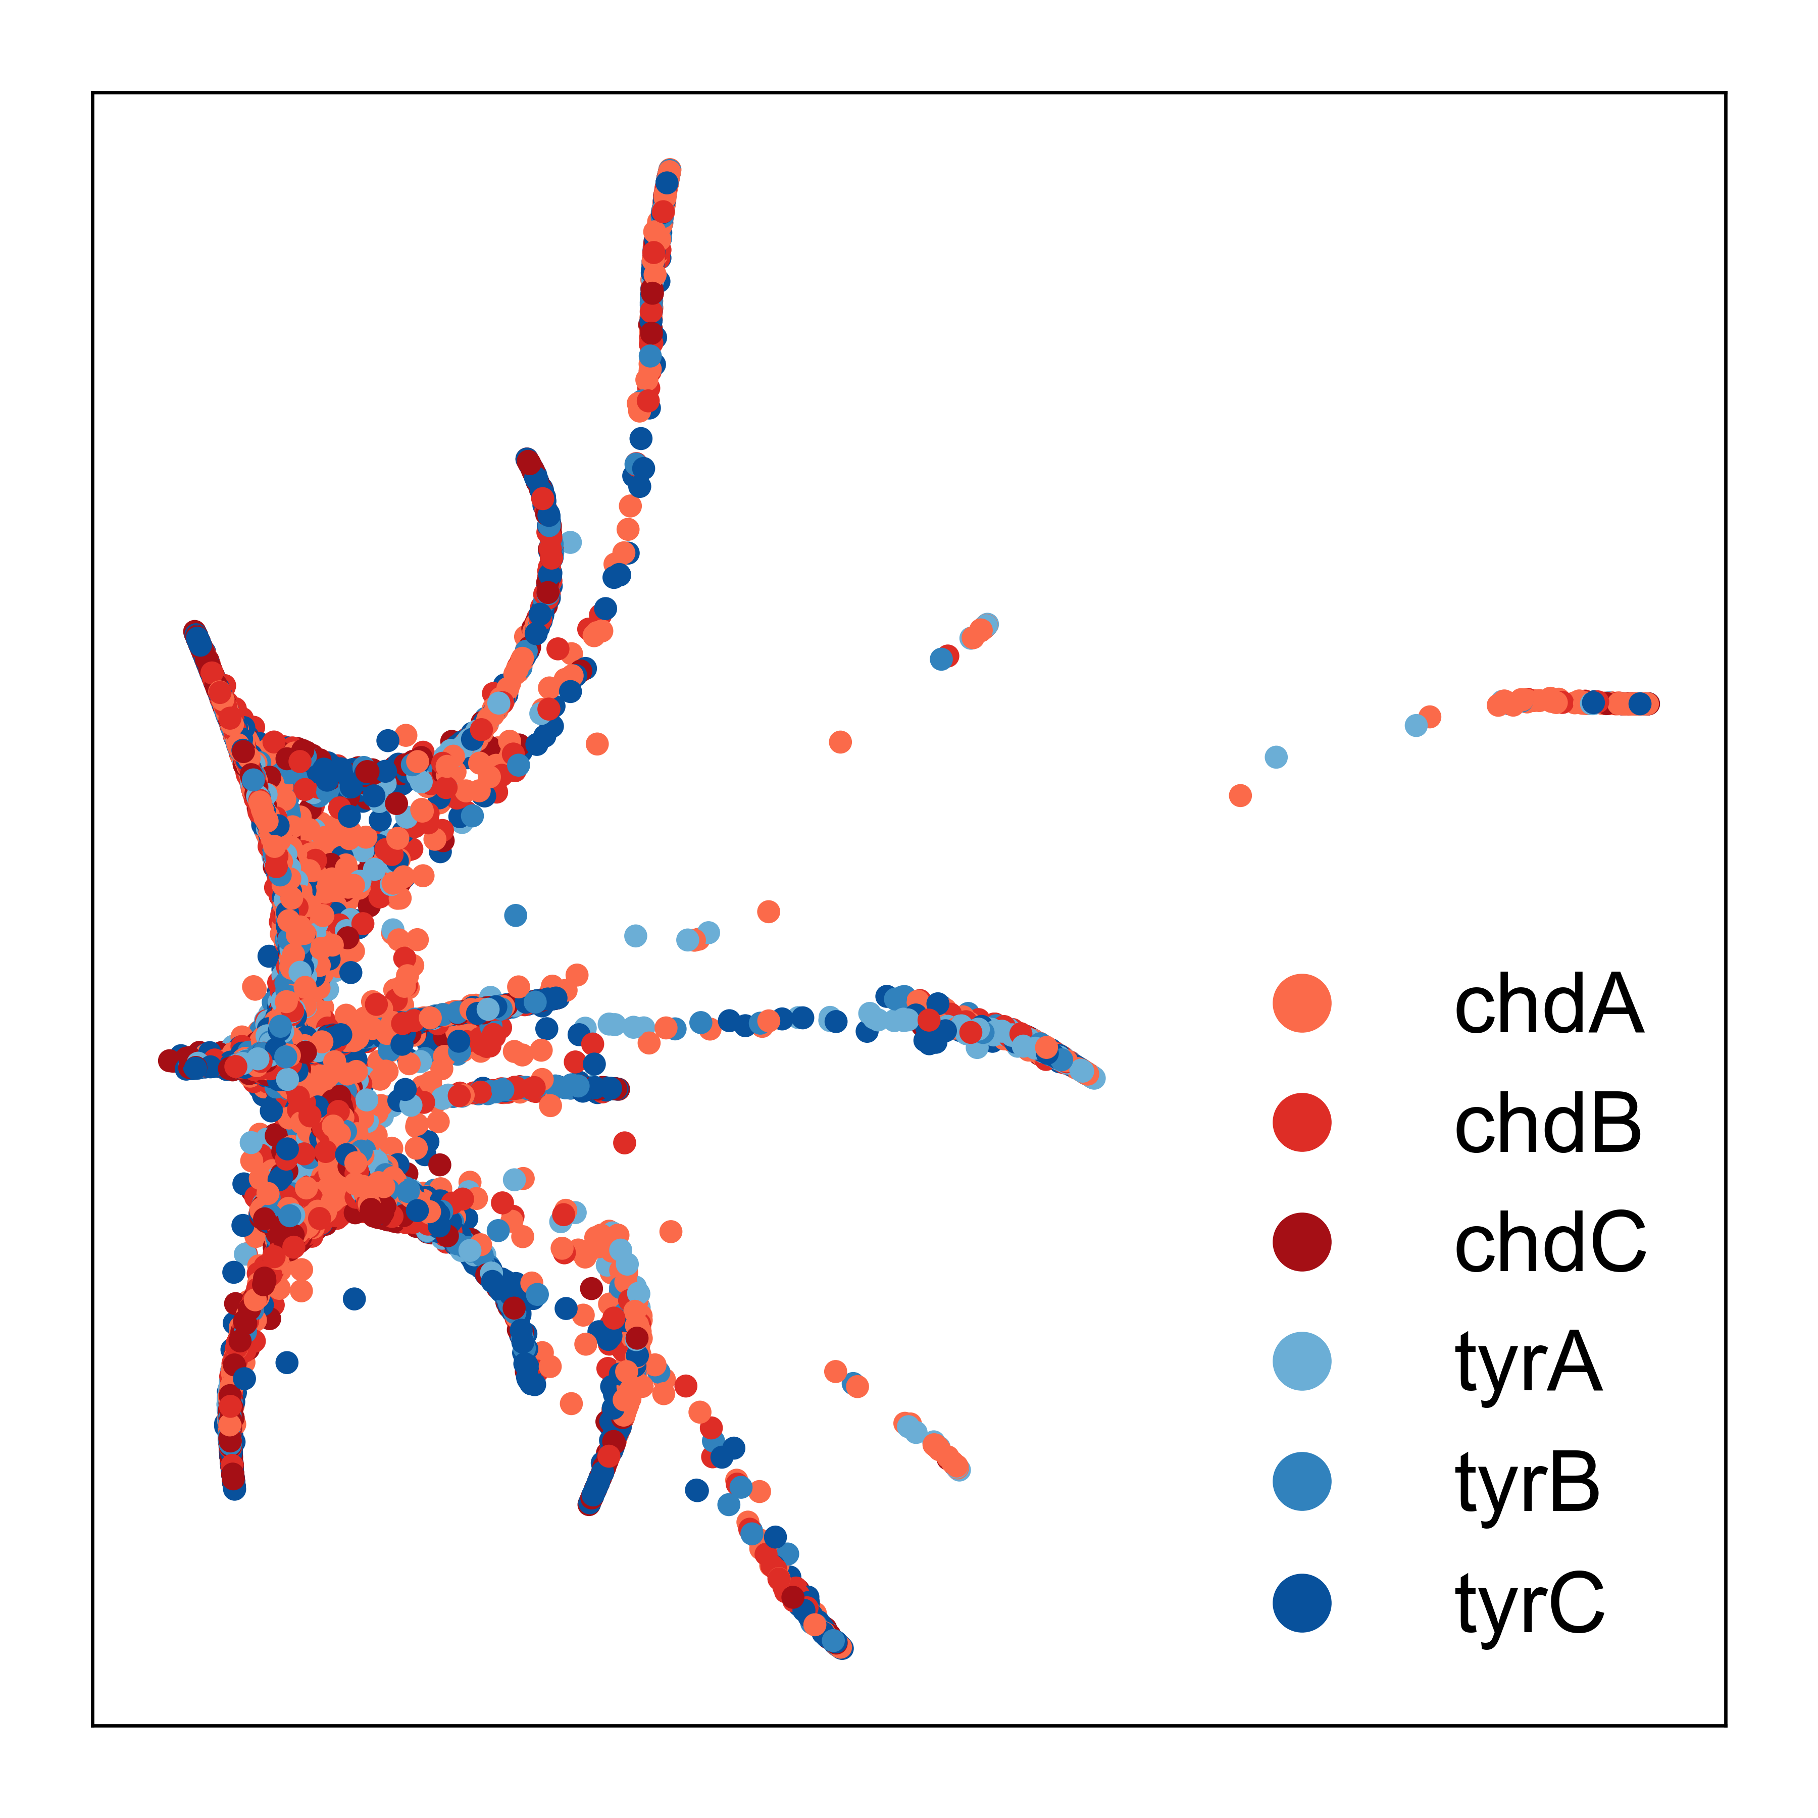
Experiment
Control
Wagner D. et al. Science. 2018.

Slide 32
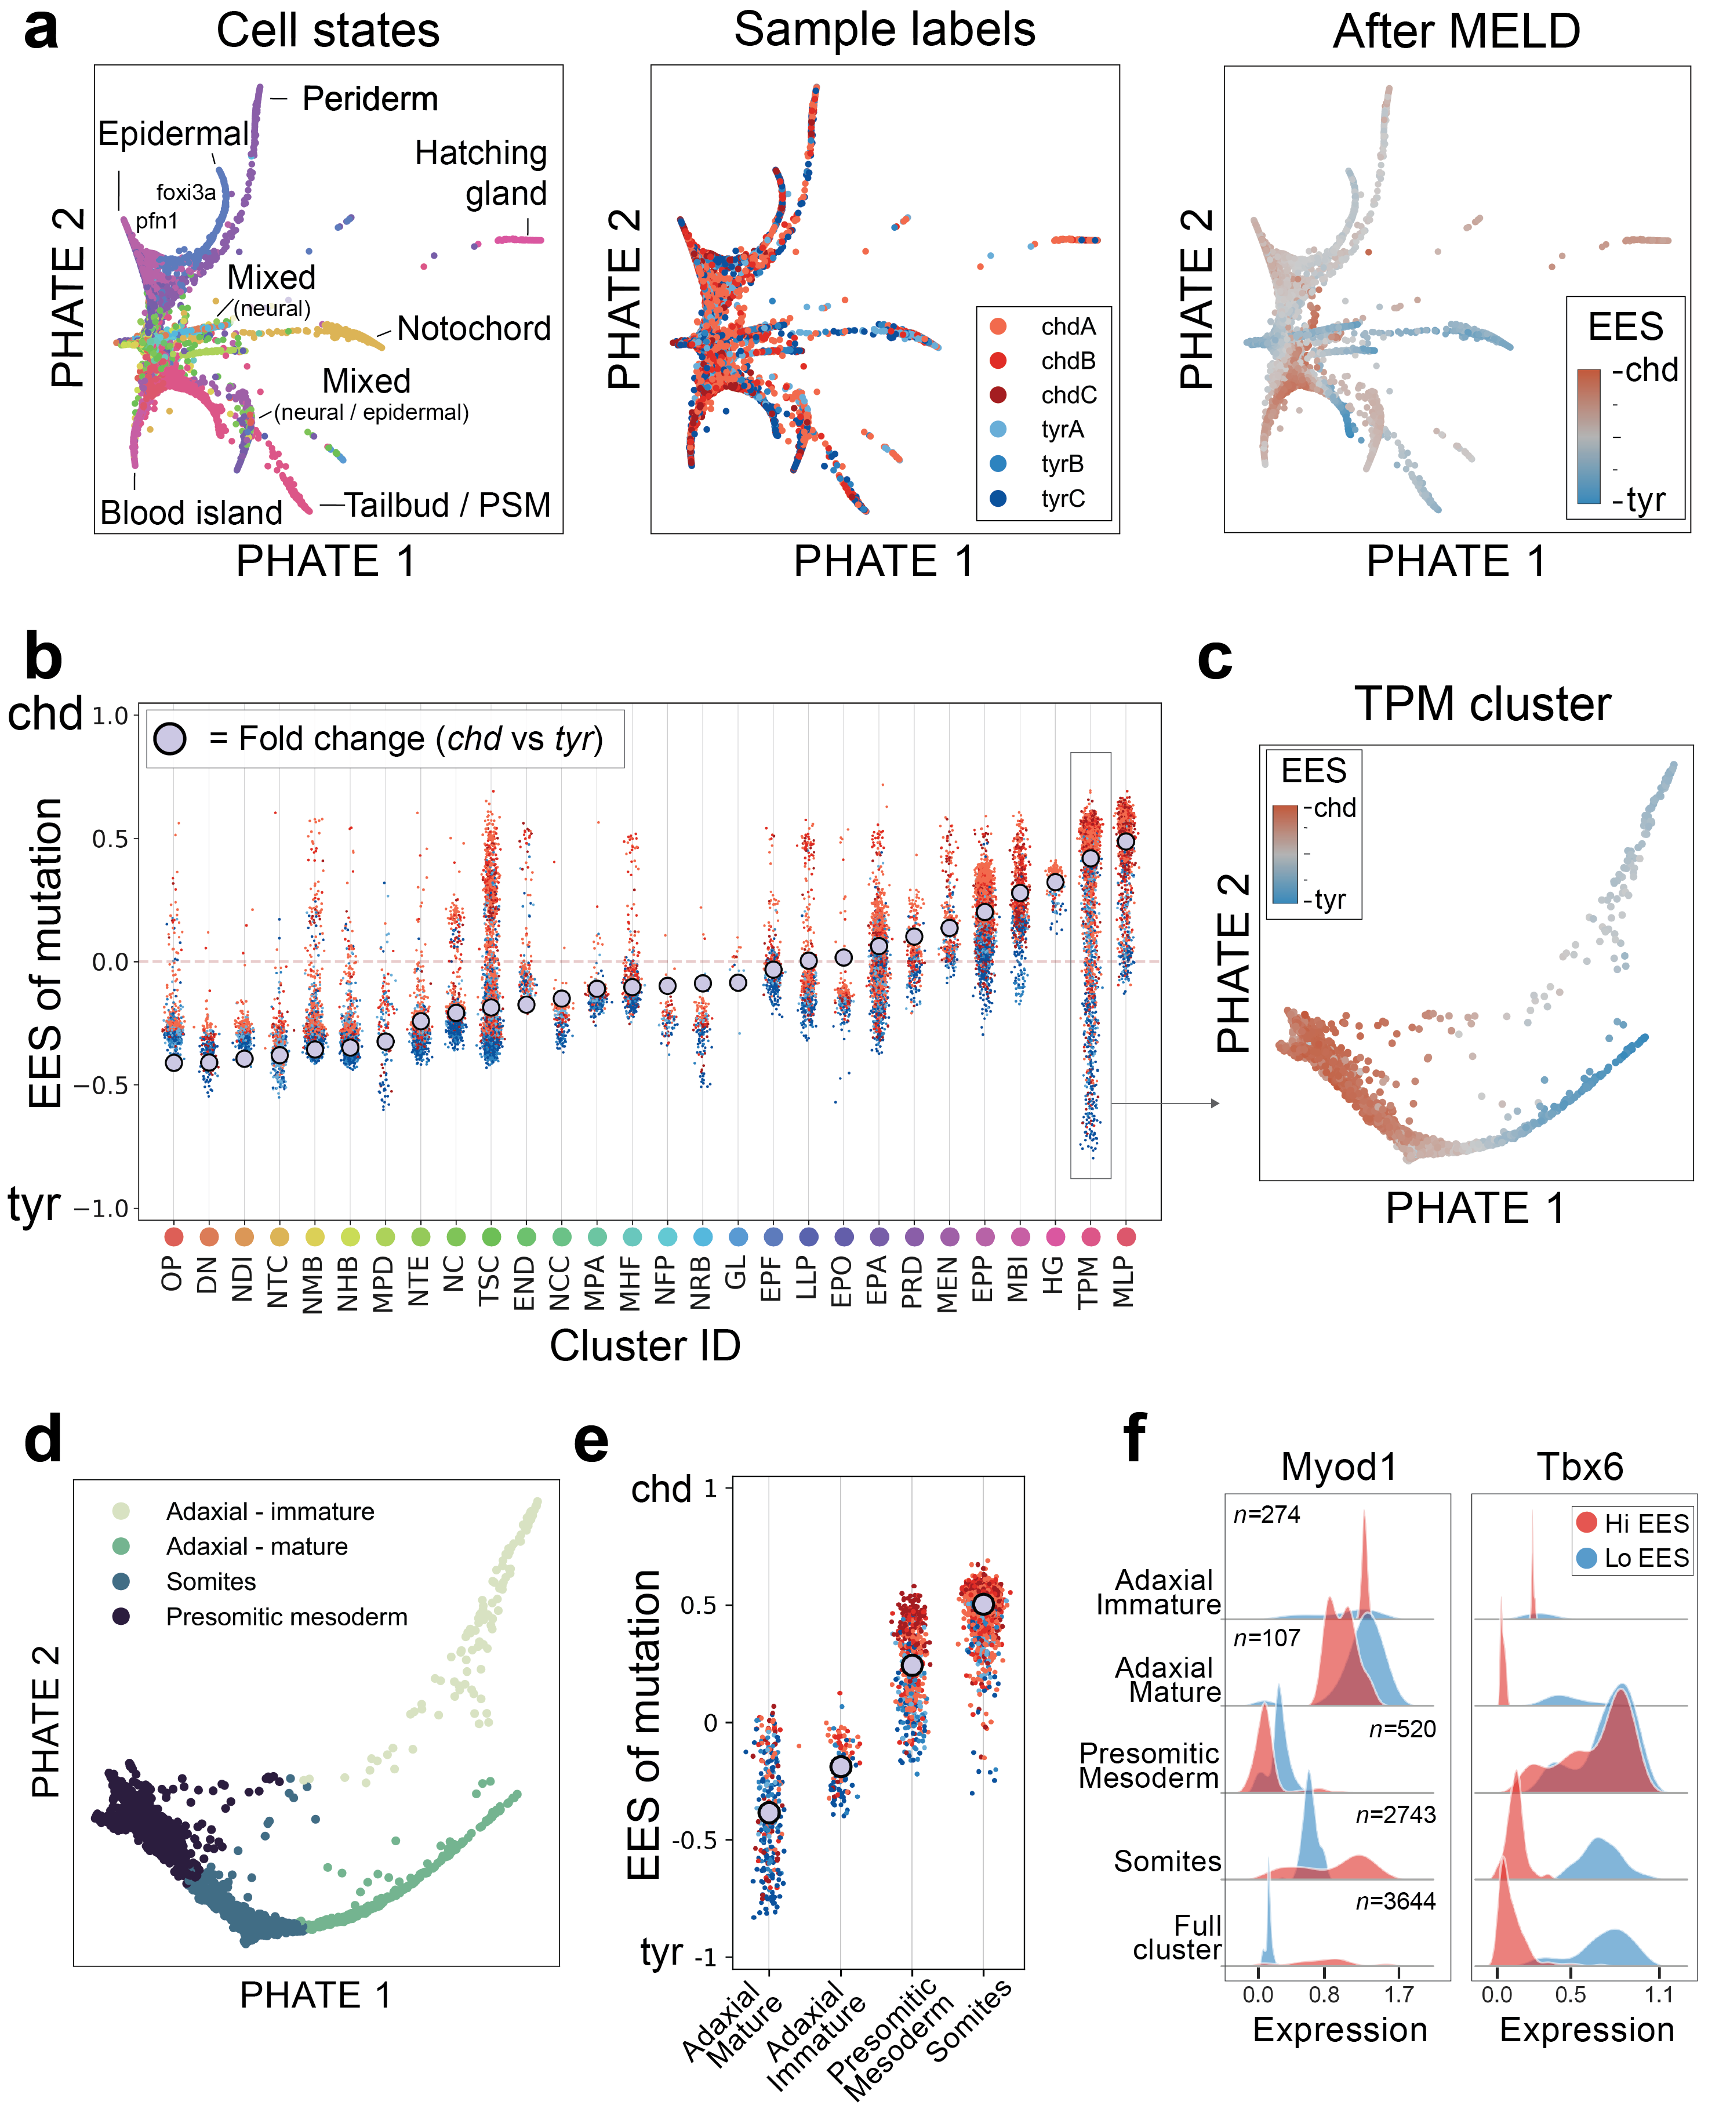

Slide 34
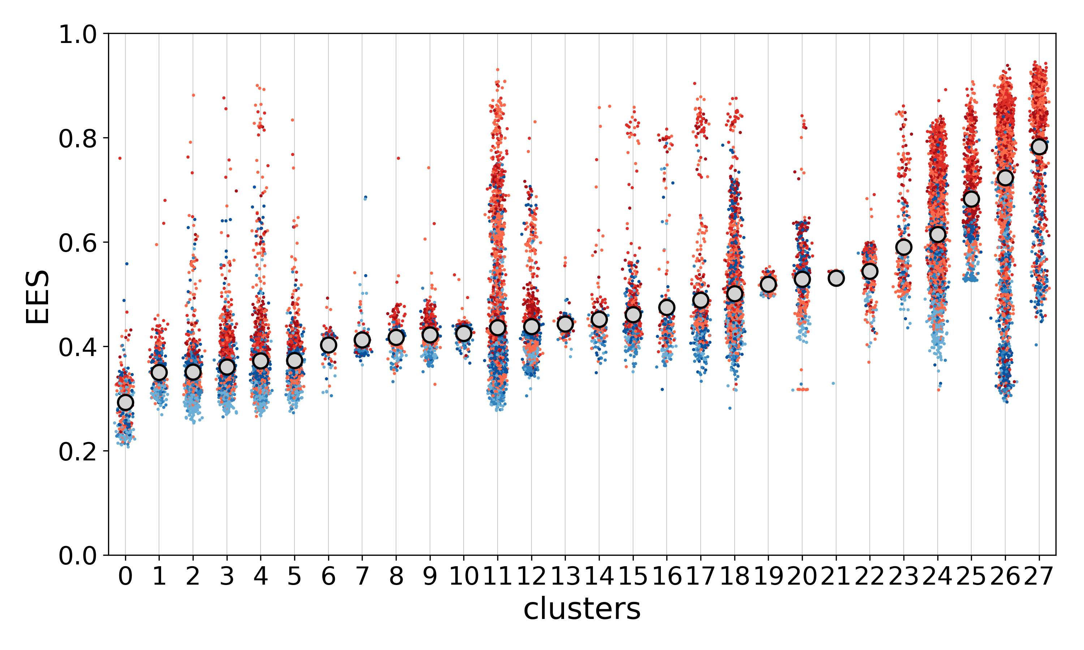

Slide 38
Conclusions
MELD provides a framework to quantify the effect of an experiment on a per-cell basis
Vertex Frequency Clustering groups cells by cell state and the effect of the perturbation
We can apply this method to arbitrary graphs, simulated single cell data, and real experimental data

Slide 39
MELD quantifies the effects of experimental perturbations in single cell datasets
bit.ly/quantsinglecell
github.com/KrishnaswamyLab/MELD
@dbburkhardt

